Slide 1
Lecture 1: Writing a Program
Part 2
based on Chapter 1

Slide 2
Class Overview
Course Information
  On the web page and Blackboard
  http://fit.mta.edu.vn
  Syllabus
  Assignments
  Homework
  Exams
  Attendance Policy
Textbook
  Tsui & Karam, Essentials of Software Engineering

Slide 3
Overview
Aims & requirements:
Providing students understandings about making a program.
Requirements:
- Reading materials before the lecture
- Attending required
Lecturing format:
  Content: activities in making a program
  Discussion: programming environment
  Self-study: Java programming
  Exercise: Build a Java program StringSorter.
Reading material: Chapter 1, Textbook

Slide 4
Objectives (detailed)
Analyze issues for simple programs
  Requirements
  Design Constraints
  Testing
  Effort Estimation
  Implementation details
Understand sequence of activities
Preview of future topics

Slide 5
Requirements
Requirements – statements that define and qualify what the program need to do.
  Defined by client, with help from engineer
  Functional – define what must be done (what a program needs to do)
  Non-Functional – qualify the functional ones (the manner in which the functional requirements need to be achieved)
Design constraints – Statements that contain the ways in which the software can be designed and implemented
  On design or implementation
  Programming language, platforms etc

Slide 6
A Simple Problem
Given a collection of lines of text (strings) stored in a file, sort them in alphabetical order and write them to another file
This is the requirement

Slide 7
Functional requirements
Input format
  Character size
  Line separator
Specify Sorting
  Numbers
  Upper/lowercase
Special cases
Boundaries
Error Conditions

Slide 8
Nonfunctional requirements
Performance
Real-time ?
Modifiability

Slide 9
Design Constraints
User Interface
  GUI, CLI, Web …
Typical input and size
Platforms
Schedule

Slide 10
Design Decisions
Programming Languages
Algorithms

Slide 11
Testing
White-Box – test the code as written
Black-Box – assume no knowledge of code
Unit testing – by programmer, on each piece
Integration Testing – Put the units together into bigger system
Acceptance testing – if it fails, client rejects program

Slide 12
Estimating
How much effort is required ?
  Usually done in person-months
Cost
  Once know the effort can estimate cost
Time / Scheduling
  Once know the effort can estimate schedule

Slide 13
Implementation Rules
Be consistent
Choose names carefully
Test before using
  Test, test, test
Know libraries
Do code reviews

Slide 14
Basic Design
Class StringSorter
  Read
  Sort
  Write
  Wrapper to do Read then Sort then Write
Will unit-test each method
Will use ArrayList to hold the lines

Slide 15
Implement
import java.io.*; // for Reader(s), Writer(s), IOException
import java.util.*; // for List, ArrayList, Iterator
public class StringSorter {
ArrayList lines;
public void readFromStream(Reader r) throws IOException
{
BufferedReader br=new BufferedReader(r);
lines=new ArrayList();
while(true) {
String input=br.readLine();
if(input==null)
break;
lines.add(input);
}
}

Slide 16
Test
public class TestStringSorter extends TestCase {
private ArrayList make123() {
ArrayList l = new ArrayList();
l.add("one");
l.add("two");
l.add("three");
return l;
}
public void testReadFromStream() throws IOException{
Reader in=new FileReader("in.txt");
StringSorter ss=new StringSorter();
ArrayList l= make123();
ss.readFromStream(in);
assertEquals(l,ss.lines);
}

Slide 17
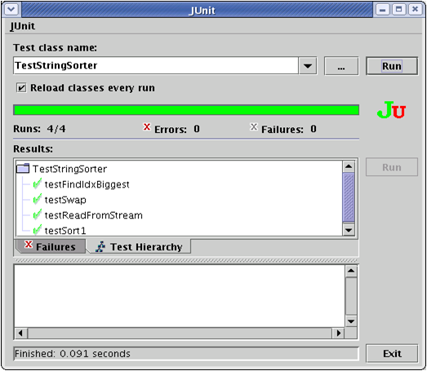
Figure 1.5: Junit GUI

Slide 18
Implement
static void swap(List l, int i1, int i2) {
Object tmp=l.get(i1);
l.set(i1, l.get(i2));
l.set(i2, tmp);
}

Slide 19
Test
public void testSwap() {
ArrayList l1= make123();
ArrayList l2=new ArrayList();
l2.add("one");
l2.add("three");
l2.add("two");
StringSorter.swap(l1,1,2);
assertEquals(l1,l2);
}

Slide 20
Implement
static int findIdxBiggest(List l, int from, int to) {
String biggest=(String) l.get(0);
int idxBiggest=from;
for(int i=from+1; i<=to; ++i) {
if(biggest.compareTo(l.get(i))<0) {// it is bigger
biggest=(String)l.get(i);
idxBiggest=i;
}
}
return idxBiggest;
}
Figure 1.8: findIdxBiggest method

Slide 21
Test
public void testFindIdxBiggest() {
StringSorter ss=new StringSorter();
ArrayList l = make123();
int i=StringSorter.findIdxBiggest(l,0,l.size()-1);
assertEquals(i,1);
}
Figure 1.9: testFindIdxBiggest method

Slide 22
Implement
public void sort() {
for(int i=lines.size()-1; i>0; --i) {
int big=findIdxBiggest(lines,0,i); swap(lines,i,big);
}
}
Figure 1.10: sort method

Slide 23
Test
public void testSort1() {
StringSorter ss= new StringSorter();
ss.lines=make123();
ArrayList l2=new ArrayList();
l2.add("one");
l2.add("three");
l2.add("two");
ss.sort();
assertEquals(l2,ss.lines);
}
Figure 1.11 testSort1 method

Slide 24
Know the library
void sort() {
java.util.Collections.sort(lines);
}
A sort routine already exists in java (and most other languages)

Slide 25
Implement
public void writeToStream(Writer w) throws IOException {
PrintWriter pw=new PrintWriter(w);
Iterator i=lines.iterator();
while(i.hasNext()) {
pw.println((String)(i.next()));
}
}
Figure 1.13: writeToStream method

Slide 26
Test
public void testWriteToStream() throws IOException{
// write out a known value
StringSorter ss1=new StringSorter();
ss1.lines=make123();
Writer out=new FileWriter("test.out");
ss1.writeToStream(out);
out.close(); // then read it and compare
Reader in=new FileReader("in.txt");
StringSorter ss2=new StringSorter();
ss2.readFromStream(in);
assertEquals(ss1.lines,ss2.lines);
}

Slide 27
Implement
public void sort(String inputFileName,
String outputFileName)
throws IOException
{
Reader in=new FileReader(inputFileName);
Writer out=new FileWriter(outputFileName);
StringSorter ss=new StringSorter();
ss.readFromStream(in);
ss.sort();
ss.writeToStream(out);
in.close();
out.close();
}

Slide 28
Test
public void testSort2() throws IOException {
// write out a known value
StringSorter ss1=new StringSorter();
ss1.sort("in.txt","test2.out");
ArrayList l=new ArrayList();
l.add("one");
l.add("three");
l.add("two");
// then read it and compare
Reader in=new FileReader("test2.out");
StringSorter ss2=new StringSorter();
ss2.readFromStream(in);
assertEquals(l,ss2.lines);
}
Figure 1.16: testSort2 method

Slide 29
Command-Line interface
import java.io.IOException;
public class StringSorterCommandLine {
public static void main(String args[]) throws IOException {
if(args.length!=2) {
System.out.println("Use: cmd inputfile outputfile");
} else {
StringSorter ss=new StringSorter();
ss.sort(args[0],args[1]);
}
}
}

Slide 30
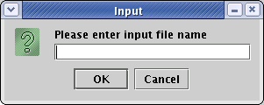
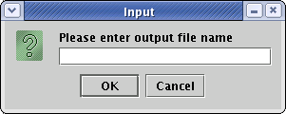
A Bad GUI
public class StringSorterBadGUI {
public static void main(String args[]) throws IOException {
try {
StringSorter ss=new StringSorter();
String inFileName=JOptionPane.showInputDialog
("Please enter input file name");
String outFileName=JOptionPane.showInputDialog
("Please enter output file name");
ss.sort(inFileName, outFileName);
} finally {
System.exit(1);
}
}

Slide 31
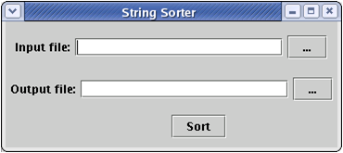
A Better Interface

Slide 32
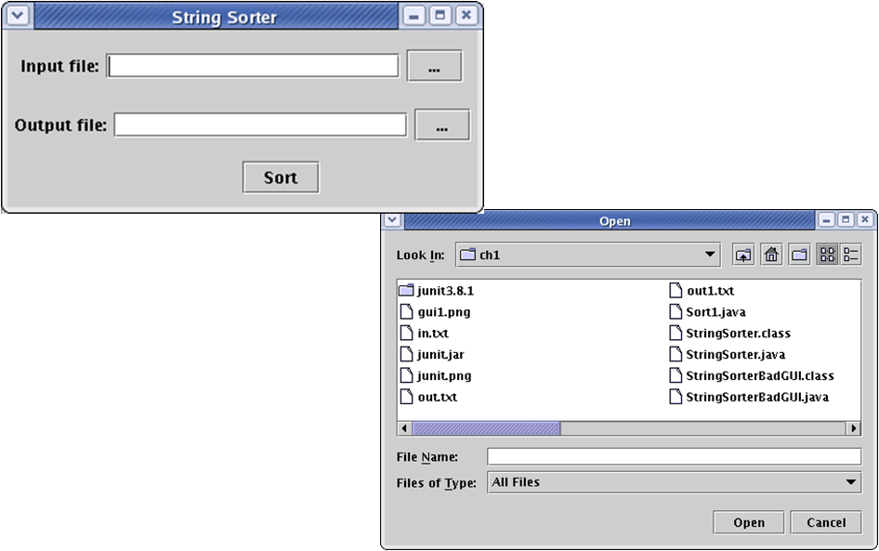
A Better GUI
Click any button, to get the open dialog

